Slide 1
PREDICTIVE MODELLING
OF CUSTUMER BOOKING
PRESENTATION

Slide 2
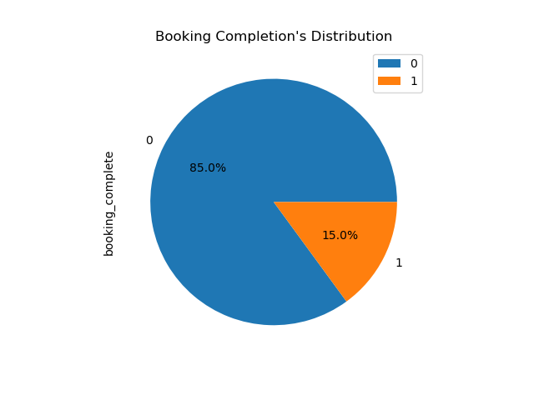
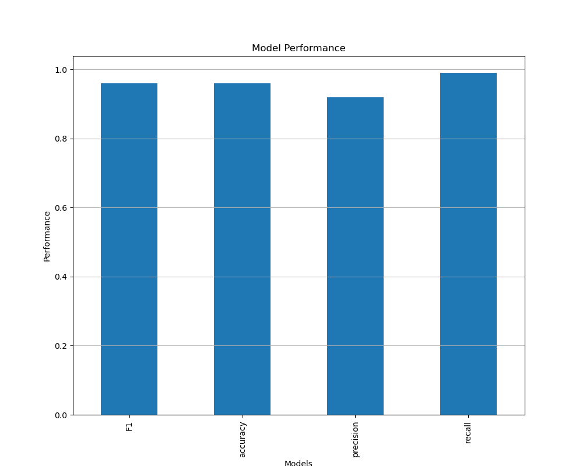
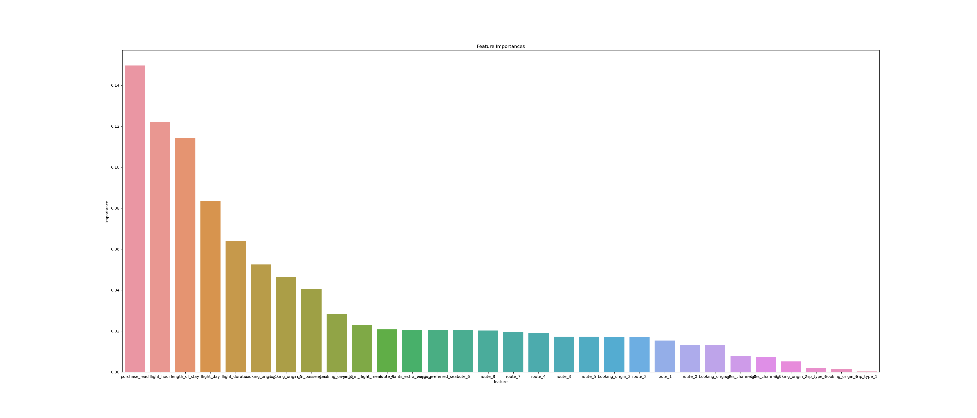
KEY INSIGHTS
• Our analysis revealed that 15% of the customers completed their booking, which means that Noncomplete rate is relatively high compared to the completion rate
• Our Model performs very well on unseen data with an accuracy of 0.95, a precision of 0.92, a recall of 0.99, and a f1 score of 0,95. A recall of 0,99 means that our model was able to identify 99% of the time, actual bookings that were completed
• purchase lead, flight hour, and length of stay are the three largest drivers that help the model predict.

